Slide 1
Self in Practice
Dr. Louise McHugh

Slide 2
Informed Consent and Confidentiality
This workshop is experiential in nature:
Designed this way to increase understanding of the theory and to help participants contact the core of the work
What might that look like….
You will be invited to take risks
For that reason we must agree to confidentiality

Slide 3
Describe yourself in three words?
One thing you are good at?
One thing you are bad at?
One thing you wish was different about you?

Slide 4
Self Matters
Many of the key psychological challenges that people face in life are fundamentally influenced by issues of self:
what career path to choose
how to interact successfully with other people
how to maintain a successful relationship
how to cope with negative life events

Slide 5
Where is your ‘self’?
Notes:
For most of us, the sense of our self is as an integrated individual inhabiting a body.
Imagine I said to you point to where your core self is?
Ferrari et al demonstrated that…
DON’T USE
The self appears to be important and even clinically relevant, poets who eventually commit suicide use I-words more than non-suicidal poets.
Basically, we discovered that in any interaction, the person with the higher status uses I-words less (yes, less) than people who are low in status.

Slide 6
YOU ARE HERE!
Ferrari et al 2008
Notes:
Because most in the mainstream only get the idea that a brain is like a muscle and if you make it stronger it will have a more efficient output. But as we will endeavor to teach the public over the coming years - there is no evidence that logic, reasoning, problem solving and so on are in -built and just need a "fit brain" in order to express themselves.

Slide 7
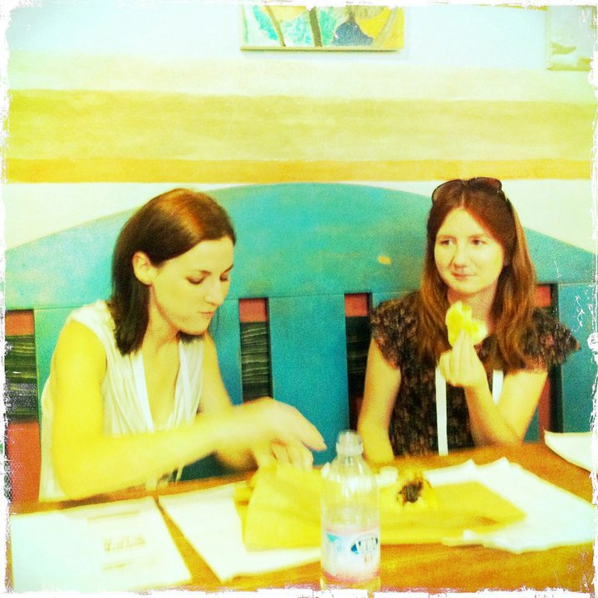
Then who were you?
I was so stressed yesterday, I wasn’t myself!
Notes:
We talk in terms of ourselves all the time. Just watch the next conversation that you have the amount of times you start a sentence with ‘I’ it can be I think I feel I believe
We are very attached to the self we talk about. And not too good and noticing that really a lot of what we say about ourselves is only relevant relative to others. I am only smart, funny or ugly when there is someone to compare to
We can easily spot the inconsistencies in other people’s accounts of their self but we are less able to spot our own, and when those inconsistencies are made apparent by the consequences of our actions, we make the excuse, “I wasn’t myself last night” or “It was the wine talking!” Well, wine doesn’t talk and if you were not your self, then who were you and who was being you?
We should be skeptical that each of us is the coherent, integrated entity we assume we are. (…that is located in the center of the head).
When you think about it, many of the ways we describe each other, such as helpful, kind, generous, mean, rude or selfish can only make sense in the context of others. So those around us largely define who we are.
There is a bit of a trap or illusion in thinking that the self exists independently of the context we are in
DON’T USE
The idea of a integrated entity suggests a self inside the head but when you think about it there can be no one inside our head considering the options otherwise, you would then have the problem of an infinite regress – still leaving the question - who is inside their head, and so on, and so on…

Slide 8
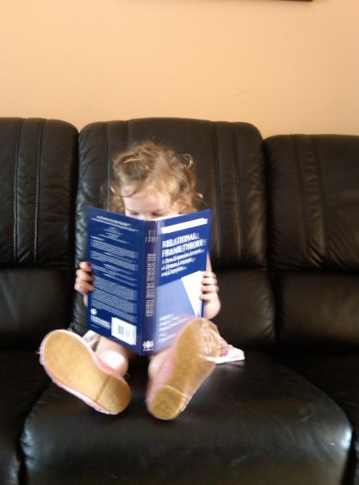
Relational Frame Theory
A theory of language that shows us how to use language intentionally
Notes:
inside a variety of psychotherapy systems and treatment protocols
What has been missing is a basic science of language that can promote vitality and minimize harmful responses to psychological pain
Like the air we breathe, language is as useful as it is pervasive, but we rarely pay attention to it unless something goes awry – such as when we can’t find the right words, there is a misunderstanding, communication breaks down, or there seems to be no way to motivate a client to change harmful behaviors.

Slide 9
Relational Framing
Relating is simply responding to one thing in terms of another
Notes:
When we understand “mother” to have a particular kind of relationship to “child” or when we evaluate something as “bigger” by relating it to something less big.
When we relate objects and events, we learn something about them
You learned all of this information without being explicitly taught, by combining the information entailed in these various relationships into a network of meaning and understanding. For this reason, the capacity to relate objects and events dramatically increases the efficiency with which we learn.

Slide 10
We can relate in many ways…
Person
(HIERARCHY) TYPE OF
I HERE NOW
(PERSPECTIVE)
GIRL
SAME AS
DIFFERENT TO
BOY
OPPOSITE OF
OLD
Notes:
10
Martha is the mother of Louise
Imaging drinking a cup of BOCEEM
Now would you like a cup of BOCEEM or the opposite of BOCEEM
And we can relate in many different ways which give richness of cognition
Function basically means the ‘effects something has’
The core of language is being able to put things into abstract relations like this that don’t depend on the characteristics of the things being related but instead depend on cues that ‘signal’ which relation is appropriate.
DEICTIC
Linguistics Of or relating to a word, the determination of whose referent is dependent on the context in which it is said or written. In the sentence I want him to come here now, the words I, here, him, and now are deictic because the determination of their referents depends on who says that sentence, and where, when, and of whom it is said.

Slide 11
Think of two things?
Now pick a number between 1 and 6
Notes:
Very complex results emerge from simple relational processes
729 questions in this simple exercise, but with a little thought each of them can be “answered” (e.g., a Kangaroo is like a chair because the young sit in a pouch)
However, formal properties per se cannot account for this -- it is not possible that every object in the world is in fact (i.e., non-arbitrarily) related to every other object in the world in every possible way
Formal properties themselves enter into relational frames, and thus contextual control over relational responding is quite arbitrary

Slide 12
How is a. . .
Thing 1 NUMBER SELECTED Thing 2
1. the same as
2. opposite to
3. better than
4. different from
5. worse than
6. the cause of

Slide 13
Notes:
about safety behaviours that maintain anxious thinking.

Slide 14
What does transformation of functions refer to?
Notes:
Touch object and make many expressions like it is hot, cold, fuzzy, sharp etc

Slide 15
Notes:
technically even an animal could be trained to produce a response to their own responding. And if it was a parrot it might even be something like ‘I just clapped’. The parot could not understand that though or do anything with it because they are not responding verbally to it.
It’s relational framing (verbally responding) about one’s own responding that is the issue. You can talk about the fact that you clapped and that you did this as a demonstration of your behavior etc. and that now you are talking about clapping and that this is a report of your own behavior etc. This kind of complex responding to one’s own behavior is made possible by relational framing.

Slide 16
Skinners vs CBS Interpretation of Self
‘There is a difference between behaving and reporting that one is behaving or reporting the causes of one’s behavior.’ (pp. 34-35).
Something more to it than this…‘[S]elf is not simply behaving with regard to [ones] behavior but is behaving verbally with regard to [ones] behavior…’ (Hayes, Barnes-Holmes & Roche, 2001)
Notes:
SAY: Nevertheless, even without invoking that process, even if we just stand back and consider Skinner’s suggestion by itself, in isolation, there is still something profoundly insightful and parsimonious about this concept that is typical of the behavioral approach.
In arranging conditions under which a person describes the public or private world in which he lives, a community generates that very special form of behavior called knowing
At a core level, self-awareness really is about responding in some way to one’s own behavior.
Skinner quote from about behaviourism
‘A person who has been "made aware of himself" is in a better position to predict and control his own behavior’ (Skinner, 1974, p. 31)

Slide 17
Self-ing
We define the self as an action (i.e., verbal responding to one’s own responding) and not as an entity.
Hence, it is arguably more appropriate within our approach to use the term ‘self-ing’ (i.e., a verb) rather than ‘the self’ (i.e., a noun)
Notes:
One important issue to note is that in contrast to mainstream traditional approaches
Heretofore we have used the noun ‘self’ exclusively because this is the more traditional approach and it would have been confusing to do otherwise.

Slide 18
CBS and the Self
At the heart of the process is discrimination of one’s own responding
Notes:
answering a question about something I’ve just eaten; e.g.,
This conception is a fundamentally important idea on which we can build.

Slide 19
A sense of self and a sense of other develop in tandem
Where are you now?
Where were you then?
What am I doing?
If I was you what would I be doing now?
DEICITC RELATIONS:
I vs YOU (interpersonal)
HERE vs. THERE (spatial)
NOW vs. THEN (temporal)

Slide 20
RFT clinical framework
Overarching goals
flexible context sensitivity
functional coherence

Slide 21
Context sensitivity

Slide 22
Context sensitivity
The degree to which we notice and respond to various elements of the context
With language anything can become anything therefore we can have functions transforming that are symbolic
Language impacts context sensitivity by multipying the potential functions of our experience
How to create context sensitivity
Mindfulness
Worksheets in CBT – antecedents and consequences
Use of metaphors – encourage clients to notice the counterproductivity of EA
Notes:
Context sensitivity is the degree to which we notice and respond to various elements of the context.
Language impacts context sensitivity by multipying the potential functions of our experience
Flexible context sensitivity is the capacity to notice various features of the context and to respond to what is most relevant. It’s an overarching goal of therapy.
Flexible context sensitivity needs to be shaped in accordance with what we know about language and cognition from an RFT perspective.

Slide 23
Context insensitivity
Humans are influenced by context which is influenced by instrinsic and symbolic contingencies
Insensitivity to useful parts of context can create difficulty
E.g., Always saying what they think in intimate relationships
Notes:
Improve sensitivity to important parts of the context – building a jigsaw

Slide 24
Connection
Loss
Sadness
Companionship
Love
Regret
Disappointment
Intimacy
Notes:
A man who lost his wife two years ago who got rid of all photos in order to remove the memory on seeing a picture of her will get in touch with a lot of symbolic functions

Slide 25
Transforming functions to alter the context
Therapists can use language tools to augment contact with the existing functions and to link existing functions to new events so as to manage what functions are likely to be selected.
Take the example of intimacy.
Notes:
Fostering intimacy requires sharing of feelings, but the functions of such sharing are multiple. Sharing feelings with others can be appealing, for example, if it means developing a sense of deep connection, but it can trigger an aversive reaction and avoidance if it is linked to fear of rejection or experiences of being judged.
If sharing feelings is mostly perceived as a risk of being rejected, and not enough as an opportunity to improve connectedness, then feelings are not likely to be shared with others. Ironically, however, if we focused crudely on trying to remove the fear of rejection or somehow talk a client out of it so as to increase intimacy we might be augmenting contact with the very functions that are preventing greater intimacy.
The goal would probably be better served by focusing on the yearning for genuine connection. In an elegant version of this approach, it might even be possible to use functions that would motivate avoidance as cues to notice functions that would motivate approach.

Slide 26
I’m scared I’ll get rejected if I get close to people.
FEAR IS NOT JUST SOMETHING TO BE AVOIDED
TRANSFORMING SYMBOLIC FUNCTIONS
If you go into fear sometimes it teaches you things. What if this fear tells you about something you want?
Notes:
In this example, the therapist is taking the painful functions of rejection and judgment by a critical mother, and using its existing link to wanting to be known and seen without judgment (“I don't even think my mother knows me, who I am. So maybe there's some hurt there”) rolls it over into the possibility of greater self-acceptance so that great intimacy is even possible. Using the metaphor of a “teacher” the therapist suggest that the pain of rejection and judgment teaches something about want the client wants – from others and (as the client herself add) for herself. The intent is to focus on and augmenting the importance of openness, acceptance, curiosity, and connection, and using the fear of rejection itself as a cue for those functions.
One way to accomplish feats of this kind even more rapidly is to emphasize new functions using the same words that describe old functions. For example, a person who is avoiding feelings in the effort to “feel good” can be asked to slow down and attend to emotions in the effort to “feel good.” A person who is over-controlling in order to avoid feeling “out of control” might be encouraged to let go so as to feel what it feels like to be “out of control” (where the tone of voice says that you mean “out” in the sense of “out of all of that” or “outside of that issue”).
Selecting and changing functions of psychological experiences is thus key to effective therapy. The question that remains is how. If we could simply change functions like we change the bulb of a lamp, our work would be simple. But therapy generally uses less direct means.

Slide 27
How do we do it?
Selecting and changing functions of psychological experiences is key to effective therapy.
The question that remains is how.
We cannot delete.
Notes:
The internet is another good metaphor for understanding how the mind works through addition, not subtraction. Large servers save almost everything that has been put on the internet. Even if it is later deleted from a particular page or website, it can still be accessed through saved past pages. When people are victims of rumors or falsehoods on internet, a good way to undermine the impact of this harmful information (whether it is true or not) is to drown it into other kinds of contents. The annoying piece of information is still available, not deleted entirely, but its impact is weaker. Similarly, if a client is excessively controlled by a difficult thought (e.g. “I am so nervous in social interactions”), other thoughts can be generated in order to influence her behavior in a useful way, without attempting to eliminate anything (for example, by asking “What would be the benefit of interacting with people?”). Cognitive reappraisal, when it means cognitive flexibility or cognitive generativity, is an example of this approach. The goal is not to eliminate or challenge – it is to broaden and build – and in some contexts it will be useful (even if in other contexts it will not, see Barrios, Forsyth, & Steger, 2006; Troy, Shallcross, & Mauss, 2013).

Slide 28
How do we alter the symbolic context of clients’ behaviours?
Addition is far more useful than subtraction.
Notes:
We cannot remove pieces of clients’ relational networks because learning does not work that way, but we can change the context in which the sources of influence occur, and we can expand networks to bring in alternative, useful sources of influence. This reduces the dominance of troublesome symbolic networks, much the way that adding water to a glass of salty water will eventually make it drinkable.

Slide 29
Functional Coherence

Slide 30
Why is coherence an issue?
A key aspect of language is coherence or sense-making
Coherence means that the language community teaches us that what we say should be internally coherent or non-contradictory
Relational framing also has this quality
As we saw previously, relational framing involves definite patterns of derived relational responding and thus when the verbal community teaches us to relationally frame, it also reinforces coherence or sense-making and punishes lack of coherence
Notes:
For example, a caregiver might frown and provide corrective feedback if a child uses the wrong name for an object or person, especially if this is repeated
Of course, there is an important context in which providing the wrong name or description for a person or thing might not be punished but instead reinforced. In humor, deliberately using a wrong name, for example, might be reinforced by attention and shared amusement. However, humor works based on a shared understanding of a lack of coherence in a particular local context, which in turn requires an understanding of the coherent relations in the broader context, so ultimately even in humor, coherence is critical. Coherence also comes to be associated with successful problem solving in both the non-social and social environments, as it allows us better prediction and control. Hence for these reasons, relational coherence becomes a powerful conditioned reinforcer.
Sense-making and problem-solving are usually highly positive things. Solving problems is often necessary in order to achieve goals connected with our values, for example. If a client is interested in pursuing a career that is more meaningful, the therapist might encourage him to compare different avenues of training in terms of their requirements and the career they would afford him. If a couple comes to therapy seeking better communication, the therapist might help them to create strategies for being more expressive and supportive to one another.

Slide 31
The Dark Side of Coherence
Clients often present for therapy with coherent descriptions of what they do and don’t do, what they will and won’t do, what is and is not possible for them.
For example, if a person has experienced repeated failures, concluding that they are a failure is coherent with their direct experience.
Further, all too often, the description of self as failure makes more likely behaviours that cohere with that description.
Apart from apparently providing a coherent excuse for avoiding things that are difficult, these descriptions are reinforcing, in part, simply by being coherent (e.g.., being right)
I am a failure! I knew it!
Notes:
Sometimes coherence can interfere with us living effectively and meaningfully.
To take a more specific example, consider the case of a woman whose face is badly scarred in an accident. Though her values might include an intimate relationship and a family, after the accident she might avoid dating, reasoning that potential partners are likely to find her appearance “disgusting” making it unlikely she will find a partner. This description is relatively coherent, and her giving up dating will only strengthen that coherence. This is problematic, however, if having a partner and a family is important to her. It can be even more problematic if she has, in the past, defined her self in terms of her appearance, even in part. In this case, she is likely to extend this evaluation, seeing herself as ‘disgusting,’ rather than just her appearance, and to behave in ways consistent with one who is disgusting (e.g., either by doing disgusting things or by going to unreasonable efforts to be seen as pleasant).

Slide 32
How does the clinical RFT framework apply to the self?
Context sensitivity – this is about being sensitive to my own experience
Functional coherence – my story about myself is only useful as far as it is workable

Slide 33
Selfing =
Verbally discriminating your own behavior from others behavior

Slide 34
What did YOU have for breakfast?
I had a banana for breakfast
No silly I had a banana for breakfast
Notes:
For example if I ask a very young child what she had for breakfast there is a chance she may well say what their sister had because they do not have an understanding of the word YOU and the word I.
She may not understand that when I ask YOU it demands a response about I
As they get older and they learn to respond to the words YOU and I they will then be able to answer that question accurately
then she might reply with what her sister had for breakfast because she has not yet learned to relate to her own behavior correctly; however, if I ask an older child she will not tend to make this kind of mistake because she has learned to relate it correctly.

Slide 35
I feel happy
I feel sad
As a child begins to relate more and more of their own behavior…
I am happier than you!
…and to compare it with that of others…
I am not as happy as you
I am a happy person!
I am a depressed person!
…they begin to have a concept of self
Notes:
As a child begins to relate more and more of their own behavior –(‘I feel happy’) and to compare it with that of others (‘I am happier than you’) they begin to have a concept of self.
As they learn to relate the self to others more and more this builds the foundation for being able to take the perspective of another
As the child’s verbal repertoire develops through interactions with their socio-verbal environment, they are taught to respond in accordance with a repertoire of perspective relations that builds on their ability to verbally discriminate behavior (understand the self and which provides the basis for perspective taking ability.
If there is a bigger there is a smaller if there is an I there is a you
DON’T USE
As we become better at relating things we can compare our behavior to that of others. For example, a small child might say that “I can run faster than you”. In this example, he is relating his running speed to that of someone else.
For example, imagine you ask me whether I would prefer vanilla or chocolate ice cream? I know I would like chocolate ice cream. Don’t ask me why, I just know. When I answer with chocolate, I have the seemingly obvious experience that my self made the decision. However, when you think about it, my decision covers a vast multitude of hidden processes, past experiences and cultural influences that would take too long to consider individually. Each one of them fed into that decision.

Slide 36
The Verbal Self
The world becomes increasingly verbal and this becomes integral to everything that the person does.
Naturally, even a person’s own behaviour becomes part of this network of relationally transformed stimuli.
I’m so clumsy!
Notes:
SAY: Indeed, in the case of the typical individual, given how much access she has to her own experience, both directly as well as through the reflection of that experience by other members of the verbal community, verbally responding to her own responding will become a core aspect of her world.
Once the individual begins to relationally frame through her interactions with the socio-verbal community, the functions of her environment will be transformed in increasingly complex and diverse ways as she elaborates her relational network.

Slide 37
The Verbal Self Concept
The self becomes a concept
Experiences we perceive are quickly evaluated and categorized
Thus, not only do we take perspective on our experiences, and notice these experiences, but we also build and derive networks around these experiences.
However, people around us reinforce us less for noticing the perspective than for noticing the content of this experience and how we evaluate it.
Notes:
Once there, a wide variety of derived relations may occur.
If you notice a sensation of pain in your stomach, you may soon generate a possible explanation for it and try to find out what you should do about it. For example, you may think that you ate something spoiled or that you are sick and need medication, or that you are hungry and need to eat again.
Even small children are encouraged to define themselves with labels that supposedly point toward relatively stable patterns of behaviors.
Parents may deliberately encourage positive labels of this kind
“you are so smart!”
“you are so caring”
But as they gain in importance they may also be used almost as levers to coerce compliance with social expectations
“you are so messy! Look at this room of yours!”
The problem with maintaining coherence of the self by behaving according to self-labels is that it can dramatically narrow the variety of our actions.

Slide 38
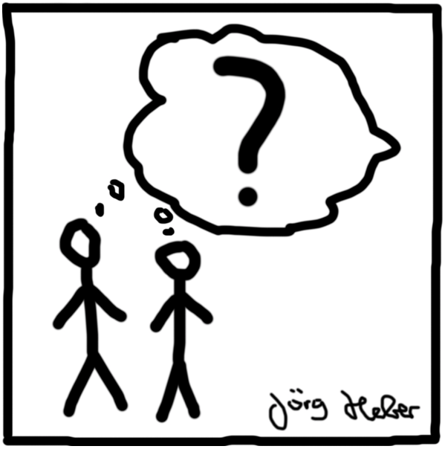
Noticing Perspective
Notes:
Stand up. Push your feet hard into the floor and straighten your spine. As you do this take a slow deep breath.
I want you to look around at the people in the room. Let your gaze move as you follow my voice. No need to get stuck looking at any one person just let your eyes wander from person to person.
Now I want you to notice that everyone in this room at some point has experienced a great success.
Now notice as you look around that everyone in this room has laughed out loud till it hurt at something they found funny.
Now notice that everyone in this room has experienced great sadness at some point.
Now notice that everyone in this room has feared feeling anxiety about an intimidating event
Now notice that everyone in this room has experienced the joy of falling in love
Now notice that everyone in this room has people who care about them
Now notice that you share with everyone in this room the fact that you too have experienced great success, sadness, happiness and love

Slide 39
ACT and The Three Selves
Self as content
Self as process
Self as context
Notes:
RFT also suggests that, in combination with an extended relational repertoire, perspective-taking contributes to establishing three functionally different types of self:

Slide 40
Moran, Almada & McHugh (2018)
Higher levels of overall mental health issues in adolescent sample were related significantly to:
Lower levels of Self-as-Process (r = −.554, p < .001
Lower levels of Self-as-Context (r = −.476, p < .001)
Higher levels of Self-as-Content (r = −.506, p < .001)
Notes:
as measured by the DASS 21
as measured by the CAMM
as measured by the Self subscale of the Self Compassion Scale-Short Form

Slide 41
Self as Content

Slide 42
Self Content issues to be targeted
Coherence
Literality
Rule-following

Slide 43
Relationship between believing thoughts about the self, psychological flexibility and general well being - Duff, Larsson & McHugh (2016)
 | Experiential Avoidance AAQ-II | Mindfulness MAAS | Defusion CFQ-13 | Well Being GHQ-12
Believeability | .465** | -.370** | .490** | .501**
Notes:
81 university students
Table 1. Correlations between believeability of negative self-statement evaluations and psychometric measures of psychological flexibility and general well being.

Slide 44
Reason Giving

Slide 45
RULES OF THE GAME EXERCISE
Each of us uses certain basic rules about the way “life is” to help guide our functioning. Although these rules are largely arbitrary, we tend to view them as absolute truth. Sayings such as “No pain, no gain” or “Where there’s a will, there’s a way” have a profound impact on how we view ourselves and life itself.
In this exercise, please take some time to “locate” the most basic rules (perhaps in the form of sayings) with which you operate in each of the content areas listed here.
1. Rules about relationships with other people (e.g. trust, loyalty, competition).
2. Rules about feeling bad inside.
3. Rules about overcoming life obstacles.
4. Rules about your relationship with yourself.
Notes:
As the exercise is discussed, the therapist can highlight any number of features of life sayings:
1. How black and white the instruction is (e.g. “Least said, least mended”).
2. How severe the consequence for non-compliance (“Haste makes waste”).
3. How the instruction favours “good content” and discourages “bad content” at the community level (e.g. “Smile and the world smiles with you, cry and you cry alone”).
4. How undesirable content is laundered to make it desirable (e.g. You’re never happy unless you’re unhappy”).
5. How undesirable content is to be addressed privately through acts of strength and will (e.g. “The Lord helps those who help themselves”).
Of special interest are general rules that emphasize overcoming life’s difficulties through control strategies or through sheer force of will.

Slide 46
Self as Process

Slide 47
Self as Process
Self-as-process, or the knowing self, is the ongoing, verbal discrimination of the psychological events that we experience as they occur in the moment.
The knowing self feeds self as content
AND is also necessary to contact ‘self-as-context’
Notes:
SAY -

Slide 48
Self as Process and Relations of Coordination and Distinction
In therapy, these types of relational frames are often used to help clients label and discriminate among their thoughts, feelings, and sensations
If the skill of naming is weak or idiosyncratic, it is hard to get what we want
Notes:
The language of emotion, for example, is a primary means of communicating our needs, desires, and probable future behaviours to others
If I avoid emotional labels I will have a difficult time saying how I feel

Slide 49
Self as Process and Relations of Coordination and Distinction
Naming my experiences is a key process in developing sensitivity to the context
If these language skills are weakly developed we have difficulty predicting and understanding the causes and consequences of our behaviour
Notes:
By observing and describing sources of influence on our actions, we are better able to notice and adapt to different contexts, rather than persisting in actions that are no longer useful
interpreting and effectively responding to events in their world, or getting their needs met effectively

Slide 50
How do self as process problems emerge? Issues with discriminating own experiences
Dominance of pliance
Absence of emotional talk
Avoidance (emerging later in life)
Deliberation distortion (caregiver says anxiety is weakness)
Notes:
PA Comments: Great
If expressions of emotions are strongly punished, children may suppress the derivation of relations of coordination and distinction
This could disrupt the development of a language repertoire that is broadly shared and understood
Strong feelings of anger might be named “annoyance”
Sexual attraction might be experienced as “disgust”
Boredom might be understood as “anger”

Slide 51
How to develop self as process
Pick a relatively non challenging emotional fluctuation for the client to notice and acknowledge.
Close your eyes, sit so that your back is away from the chair or straight and upright. Now become aware of your breathing. You don't need to try to control it. Just let yourself breath in and out, let yourself feel how it feels. Witness your breath. Try to be with your breathing for the next minute. If at some time you think that it is silly or boring just let yourself sit there and notice that these are thoughts. Now hold your nose with your thumb and hand – notice what this feels like. Let go of your nose and notice if your feeling changes.
Notes:
The therapist can build from simple examples of changing emotions – such as from when they are able to breath to not able to breath to other more subtle or difficult to acknowledge emotional responses.
Gradually the therapist will introduce exercises in session that involves asking the client to label their internal experience as they occur freely in session.
For example, if the therapist notices the client fidgeting they may say ‘I notice that you are fidgeting with your hands, what is your experience at this moment?’
Below is an example of a brief exercise that gets the client present to their current experience of breath and how blocking breathing may change how they are feeling.

Slide 52
Self as Context

Slide 53
Self as Context Definition
In the broad sense, self as context has been described as a process involving ‘…the coming together and flexible social extension of deictic framing – especially I HERE NOW – to enable observation or description from a particular point of view that facilitates as outcome a wide variety of experience including defusion, acceptance, compassion, empathy, theory of mind and a transcendent sense of self’ (Hayes, 2011).
Notes:
At its core, self-as-context pertains to the continuity at the heart of deictic relational framing, which is that someone engaged in such framing is always answering from a perspective of I-HERE-NOW.
They may not always clearly and immediately contact that continuity even as they answer questions about their behavior or that of others, but it is always there to be contacted.
The experience of self as context which arises from this continuity can be understood both broadly and narrowly and also as both process and outcome.

Slide 54
Self as Context Exercises
Observer you
Self compassion exercises
Mindfulness exercises
Future you
Chessboard metaphor
Inner Child
Perspective taking exercises
Who is noticing that?

Slide 55
How can we find a balance between stability in the self and variability in the behavioural repertoire?

Slide 56
Camera metaphor
A stable position allows
you to get a better perspective
on things.
When the photographer sets the camera down in one location this sets the perspective. If after allowing the camera to take pictures over a particular period the photographer then reviews the results she will see how the scenes change over time. For example, she will see that the exact same spot changes from darkness to light, that things enter the view and leave, and even that things constantly in view change in appearance across time.

Slide 57
Content
My Thoughts
’I am silly’
‘I am caring’
’I am bad at maths’
My Sensations
Cravings
Tingles
Cramps
My Feelings
Jealousy
Anxiety
Sadness
I
Coordination
Relation (=Me)
Coordination
Relation (=Me)
Coordination
Relation (=Me)
I
Context
Hierarchical
Relation
(includes)
Hierarchical
Relation
(includes)
Hierarchical
Relation
(includes)
My Thoughts
’I am silly’
‘I am caring’
’I am bad at maths’
My Sensations
Cravings
Tingles
Cramps
My Feelings
Jealousy
Anxiety
Sadness
Coordination
Relation (Mine)
Coordination
Relation (Mine)

Slide 58
Self as Context - Flexible Self-ing- How to Do It
Target | Example
The variety of experience: I as various | How do you feel now, and now and now? Remember different situations and moments of your life. How did you feel then? Is that different to how you feel now?
Stability in a sense of perspective: I as perspective | Notice who is noticing thoughts, sensations and feelings across a variety of experiences in your life e.g., last summer, five years ago, when you were a teenager. Notice who is noticing the experiences of you today, yesterday, in a year’s time
Distinction and hierarchical relations: I as container | Your experiences are part of you You are the container of all your experiences
Able to respond in line with values in action: I as flexible | Given your history it is not surprising that you made these choices. Now with this knowledge (that your experiences are only part of you) what can you do that is in line with what matters to you? (i.e., you are able to respond)
Notes:
Here are the main principles to remember:
Fostering a great awareness of experience decreases rigidity by allowing the client to notice the variety of his experiences and notice that if he was these experiences, he could not be completely defined by just a few of them. Developing these self-awareness skills consists of:
Stabilizing the perspective by repeatedly directing the client’s attention to the present, so as to help him notice the changes in his experiences.
Changing perspective by exploring a variety of contexts to help the client notice the changes in experiences and self-labels across contexts.
Observing experience from different points of view defined by time, place, and person, which increases awareness of the variability of experience itself.
Fostering a sense of perspective increases stability by allowing the client to notice what is common to all his experiences. Developing a sense of perspective skills consists of:
Helping the client notice the common perspective across all experiences, actions, and labels. Helping him notice that there is something he does (“a part of himself”) that is stable: the activity of noticing from I-Here-Now.
Helping the client notice the common perspective across points of view defined by time, place, and person. By noticing the changes in the perception of experience, it is easier to notice the I-Here-Now aspect of awareness when it is present.
Fostering a more contextual sense of self that integrates the qualities of the self-awareness of experience and the sense of perspective into a coherent network based on hierarchical relations. Developing these skills consists of:
Emphasizing the hierarchical dimension of the self by using metaphorical forms of language that replicate the relation between a context, or a container, and a content.
Emphasizing the distinction between the self and the experiences by redirecting evaluations about the self toward the experiences.
Fostering an interactive sense of self that encourages approaching responsibility with flexibility, which prevents unnecessary self-criticisms and hopelessness. Developing this interactive sense consists of:
Helping the client be more aware of the influence of contextual variables on his actions (e.g., using perspective taking)
Directing the client’s attention toward the impact of his actions on the contextual variables.

Slide 59
I as Various
Help the client notice the flow of experiences
Help the client stop moving
Formal meditation can do this
Via language – right now, and now and now in this moment
Notes:
That makes me feel exercise

Slide 60
Variability in Perspective

Slide 61
I as Various
We can help the client become aware of the variability of their experience by getting them to bring to mind different views they hold about themselves at different times, with different people and in different situations

Slide 62
Exercise
Client: Indicate that you believe you are constantly feeling or being a certain way
Therapist: Help the client to notice the variability of their experience in session:
by tracking it here and now as it changes
OR
by looking at how they view themselves in different times, with different people

Slide 63
I as Perspective
Noticing common perspective across experience and points of view
You are the observer of all your experiences and views
Notes:
If we were only to notice the constant change of experiences but still believe that we are those experiences our sense of self would probably feel extremely unstable
In development a sense of perspective emerges alongside a sense of awareness.
It is important to notice the distinction between perspective and experience

Slide 64
I as Perspective: Noticing Common Perspective Across Experiences

Slide 65
I as Perspective: Noticing common perspective across points of view

Slide 66
I as Perspective exercise
Client – be a client with a rigid label or view of themselves at the moment
Therapist – help the client:
Noticing common perspective across experience
You are the observer of all your experiences or views

Slide 67
I as Perspective via perspective relations
Perspective 1
Think of a time when you were in distress that someone invalidated your pain?
Contact how you felt at that time
Perspective 2
Think of a time when you invalidated someone else’s pain when they were distressed
Now contact how you felt then
Now contact how they felt then
Contacting what you would do differently
Now imagine yourself going back in time and responding differently to this person

Slide 68
I as Container
Emphasizing the hierarchical dimension of the self
You are the container of all your experiences
Emphasizing the distinction between the self and the experiences
You are not any one experience as these will change
Notes:
Processes of symbolic derivation prevent us from limiting our language activity to noticing our experiences or taking perspective
We need to be able to predict how we will feel if we take one course of action or another

Slide 69
I as Container: Emphasizing the hierarchical dimension of the self
Deliberate use of hierarchical framing
Leading the client to formulate her experiences as something she has rather than something she is is a good and simple way to build hierarchical relations.
Notes:
Foody et al

Slide 70
Hierarchy
I am the container of all my experiences
I’m having the thought that I am a failure
I am having the feeling of sickness
I am having the feeling of being scared
Notes:
Relations of inclusion, ranking or category
E.g., I am a context of all my experiences
This can allow us to look at the whole or the elements
What is whole at one level is elemental at another and vice versa

Slide 71
I as Container: Emphasizing the distinction between the self and the experiences
Separate experience from action
Another technique to improve I as Container is to redirect evaluations about the client toward their actions, thereby using distinction framing between the self and psychological experiences.
When evaluations of actions merge with the self, the risk is that the self becomes the target of change if the evaluations are unsatisfying.
Notes:
Instead, a conceptualization of the self as the context containing a variety of actions suggests that no matter what is done, the self is above these actions. Observe this technique in the following exchange:
Client: I feel horrible. I can’t believe I was so stupid to trust him again. I guess I must be a really naïve person. I always have been…
Therapist: You feel like it was stupid to trust him again? (Redirects the evaluation toward the action)
Client: Yeah. I wanted to give him another chance but I am just too naïve.
Therapist: What is naïve in what you do? (Redirects the evaluation toward the action again)
Client: That I still think he can change.
Therapist: What did you do because you thought he could change? (directs the client’s attention toward her actions)
Client: I prepared a weekend together. He had said that he would be done with his work by Friday night and we could leave early Saturday. But when he came back from work on Friday night, he said he would still have to work on Saturday morning and we would have to leave in the afternoon. I just couldn’t see the point of going out for the weekend if we arrived late on Saturday. So I said we should cancel.
Therapist: I hear that you really wanted to spend this weekend together. That must have been really disappointing.
Client: Yeah. I am disappointed by him and by myself for being so stupid.
Therapist: What do think you could do to avoid having a weekend together be ruined again? (Helps the client target actions rather than the self to change outcomes)
Client: I need to stop being naïve.
Therapist: What would you do differently, that would not be naïve? (Redirects the evaluation toward actions again)
Client: I would have to tell him that I don’t think he can get his work done by Friday night if he doesn’t arrange his schedule better during the week.

Slide 72
Self as Context Research
Two types of relating have been found to be critical for Self-as-Context, and each of which has separate implications for mental health (Foody et al., 2013, Foody et al., 2015; Gil-Luciano, Ruiz, Valdivia-Salas, & Suárez, 2017; Luciano et al., 2011).
Distinction relations
Hierarchical relations

Slide 73
Self Intervention: Hierarchical versus Distinction Relations
Distinction self as context
I-YOU and HERE-THERE explicitly facilitating distinction between self and experiences
Hierarchical self as context
I-HERE-NOW contain my experiences
LOWER LEVELS OF DISTRESS AFTER HIERARCHICAL
Foody, Barnes-Holmes, Barnes-Holmes & Luciano, 2013
Notes:
http://www.ijpsy.com/volumen13/num3/368/an-empirical-investigation-of-hierarchical-EN.pdf

Slide 74
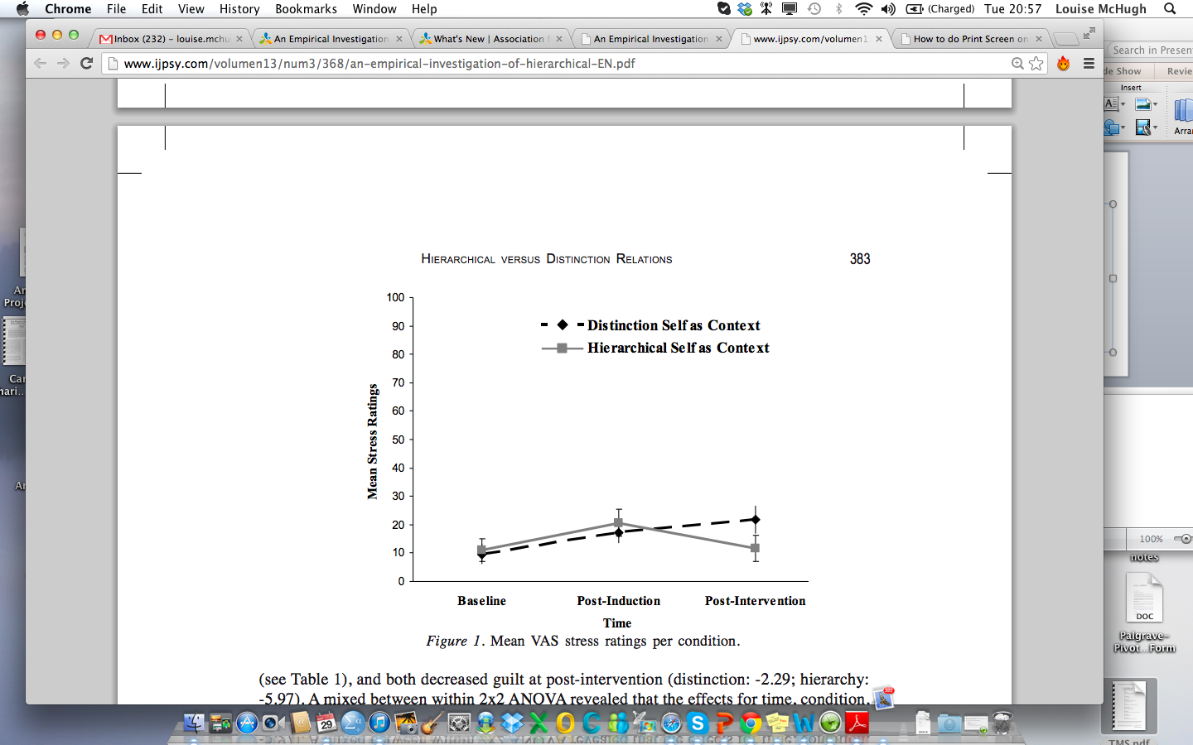
Self as Context Hierarchical versus Distinction Relations
Notes:
However, both were associated with significantly less believability, less guilt,
Induction involves writing and saying a negative self referential thought
less vividness, and significantly less distraction.
MORE CLEAR HERE

Slide 75
Using Hierarchical Relations to improve your SAC interventions…
Deictics and distinction
Each time a thought pops into your head, imagine putting it on one of those leaves…Just imagine yourself on the side of the bank watching this thought go down the stream
Deictics and hierarchy
And just notice that it is you who is noticing your thoughts. Be aware that you are here and your thoughts and images are there on a leaf floating down the stream. If the stream never gets going at all and you start thinking “It’s not working” or “I’m not doing it right” then let that thought be placed on a leaf and send it right down the stream as well.
Notes:
GET THEM TO TRY THIS OUT IF TIME
Foody et al = 18 per group
Think of a negative thought about yourself
Only one published study has investigated the way in which deictic relations may be altered using ACT-based techniques, such as defusion and self as context (i.e., Luciano, Ruiz, Vizcaíno-Torres, Sánchez-Martín, Gutiérrez-Martínez, & López-López, 2011). In their ‘defusion I’ condition, these researchers attempted to facilitate defusion or separation between the self and content with adolescents at high or low risk of conduct dif culties. For example, participants in the defusion I intervention were instructed to “Just contemplate your thought as if you were contemplating a painting”. With a similar but naïve sample, their ‘defusion II’ condition employed a more extensive protocol of ACT-based techniques that speci cally attempted to establish hierarchical relations between the self and the content (e.g., “Imagine yourself so big as to have room for all of the thoughts you have had today”). The ndings indicated superiority on a range of measures of clinical improvement (including reductions in problem behavior) for defusion II over defusion I. In short, it was more bene cial for the participants to learn to adopt a hierarchical perspective with regard to their content, rather than a simply distinct perspective. These outcomes not only provided insight into the middle level concept of defusion, but illustrated its potential overlap with the deictic relations and self.

Slide 76
I as Flexible
Noticing impact of context
Noticing the impact of behaviours

Slide 77
I as Flexible: Noticing impact of context
Ask questions about a variety of current and past elements that may contribute to the clients ineffective action
Can you think of things that characterized that day that might have led you to acting this way?
If you were me right now, how would you view this situation?
Given your history how could it be any other way?
*Don’t have to shoulder all the responsibility

Slide 78
I as Flexible: Noticing the impact of behaviours
Impact of clients own influence
When you study how does that impact your grades? Your relationship with your parents?
*And you are able to respond
Notes:
Applying for job improves relationship

Slide 79
I as Flexible: Linking Causes and Consequences

Slide 80
I as Flexible
Write down something that you no longer do that you miss?
What led you to stop doing it?
What was happening around that time in your life?
What was it that was important to you about doing this?
What have you missed since stopping it?
In service of my value, I am willing to_____________ .”
Notes:
The therapist asks group members to share one or all of their committed action plans to bring the pieces back into their lives. She has each group member identify one thing he is willing to do today to put a piece back into his life. Finally, she has each group member stand up and state, “In service of my value, I am willing to .”
Write down something meaningful to you?
Something purposeful to you?
Something you used to do?
Something that you no longer do?
What does that tell you about what you value in that area?
In service of my value, I am willing to_____________ .”

Slide 81
I as Flexible: Noticing the impact of context
Client: Talk about something you did that you are feeling bad about
Therapist: Ask questions about a variety of current and past elements that may contribute to the clients ineffective action
Can you think of things that characterized that day that might have led you to acting this way?
If you were me right now, how would you view this situation?
Given your history how could it be any other way?

Slide 82
Flexible perspective taking exercise

Slide 83
Geoff – Self-ing Issue
I’m just... nothing. I’m not even worth my own time or effort. I don’t do anything that matters. I am not the father I would like to be to my children. I am distracted when I am around the kids and so I cannot engage with them and have fun like fathers should. And things I do try, I always manage to screw up somehow. To the people in my life, if I’m not totally inconsequential, I’m causing unnecessary pain. I can’t stand me. I can’t imagine how anyone else could. I should just stay away and save everyone the trouble.

Slide 84
Issue | Example
1. Lack of values clarity | ‘I don't really know what I care about’
2. Self-righteousness | ‘I’m more honest than you. I’d never lie like that’
3. Operating on auto-pilot | ‘Sorry, I missed that; I’m up to my neck in it’
4. Own experiences feeling threatening | ‘I can’t stand these feelings’
5. Self-centeredness / Lack of perspective | ‘I don't care how he feels, he brought it on himself!’
6. Hyper-attentive to views of others | ‘Have I offended you? Are you upset with me?’
7. Lack of connectedness to others | ‘I don't fit in – I’m different’
8. Personal rigidity | ‘But this is just who I am’
9. Sense of emptiness | ‘I feel empty. There is nothing to me’
10. Painful self-judgment | ‘I should have said something; I’m so weak’

Slide 85
Questions?

